Slide 1
OFFICE 365 How to Log in and get started
This is how you can access your HIsd e mail and tools like
Microsoft word
Microsoft excel
Microsoft power point (so you can do power points like this one)

Slide 2
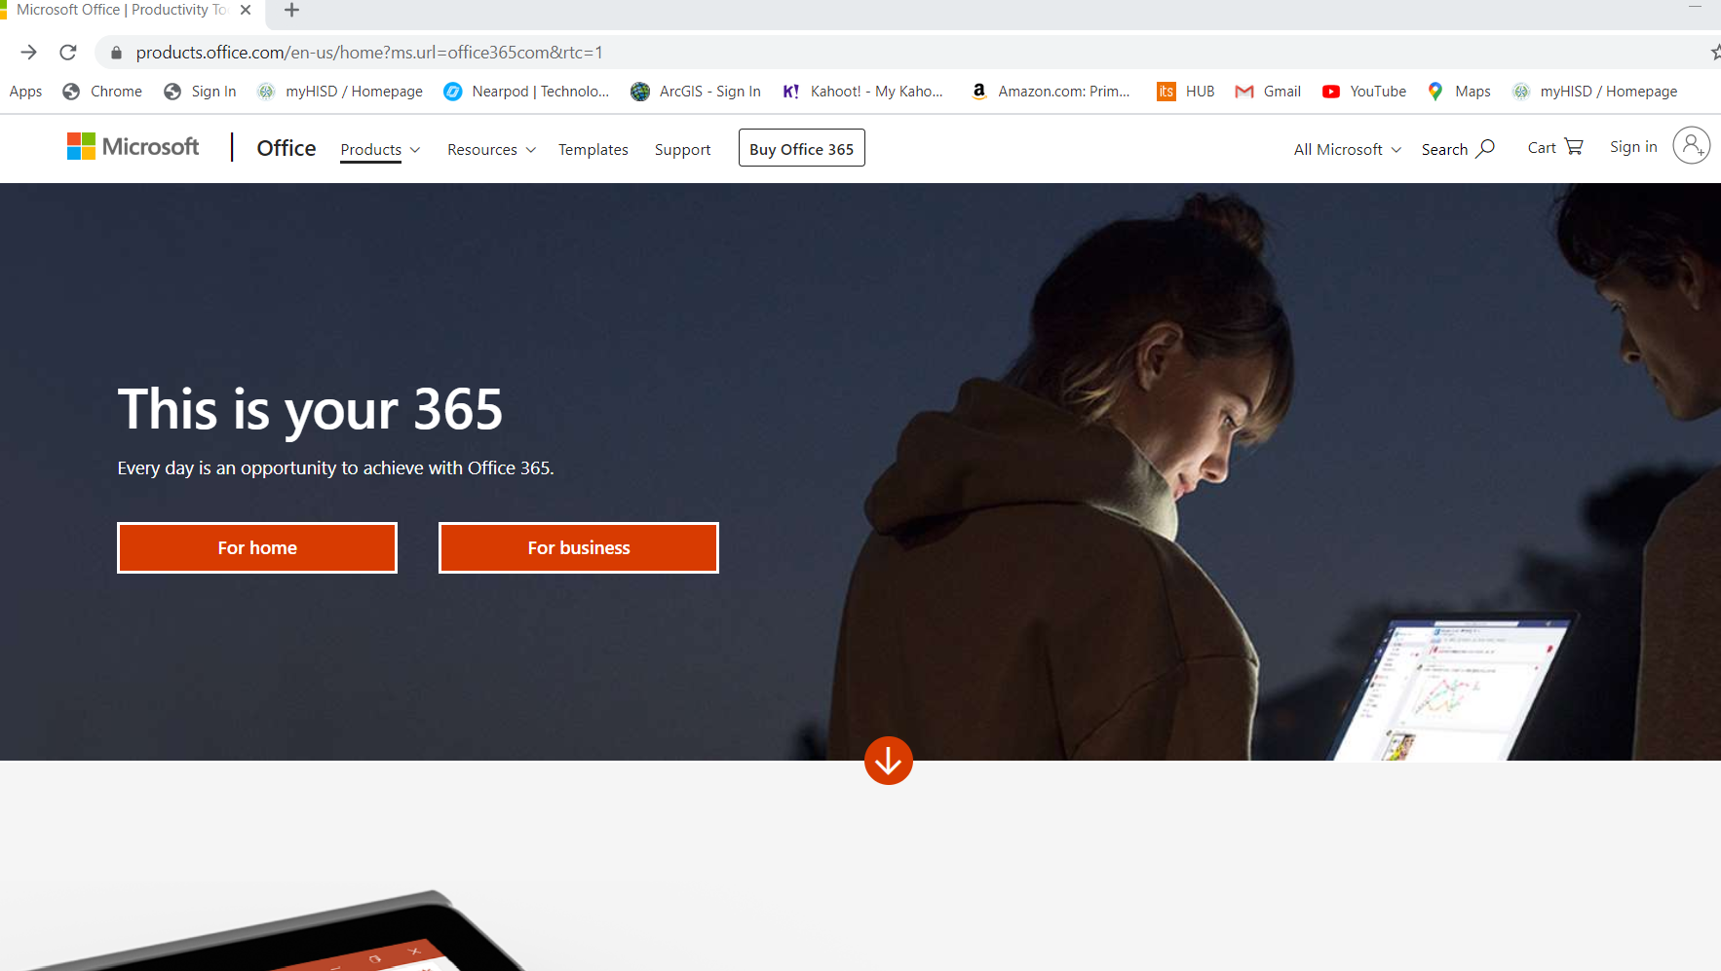
Go on your browser and type in:
www.office365.com

Slide 3
Look for the sign in button on top right of the page.

Slide 4
HISD sign in use your student number
This is an example of how the sign in page will look like after you have entered your student number.
IMPORTANT – remember to put the "S" before your number.

Slide 5
Password part
password for HISD account is:
Your birthday in full numbers - for example -
March 9, 2004 would be:
03092004 that's the password

Slide 6
MORE PASSWORDING BUSINESS
You may get this window asking you if you want to stay logged in or not. If you share your computer or laptop it might be better not to stay signed in.

Slide 7
YOU DID IT!!! YOU'RE IN!!! LOOK AT ALL THAT FUN STUFF!!!
You have an incredible selection of tools at your disposal for doing all kinds of work.

Slide 8
Your hisd email
OUTLOOK is the your email portal for HISD email.
We will be using this email to communicate during this period. Using the HISD Office365 suite we will also be able to share and cooperate work and assignments.

Slide 9
Let's begin with these – take some time to open and play with these tools
WORD is the most important – we will be using this one often
POWER POINT can be a lot of fun – you will be doing projects on Power Point, so start having fun and create a story for your friends

